Slide 1
Threat Model Using MITRE ATT&CK
Use case: Feedback Sharing System

Slide 2
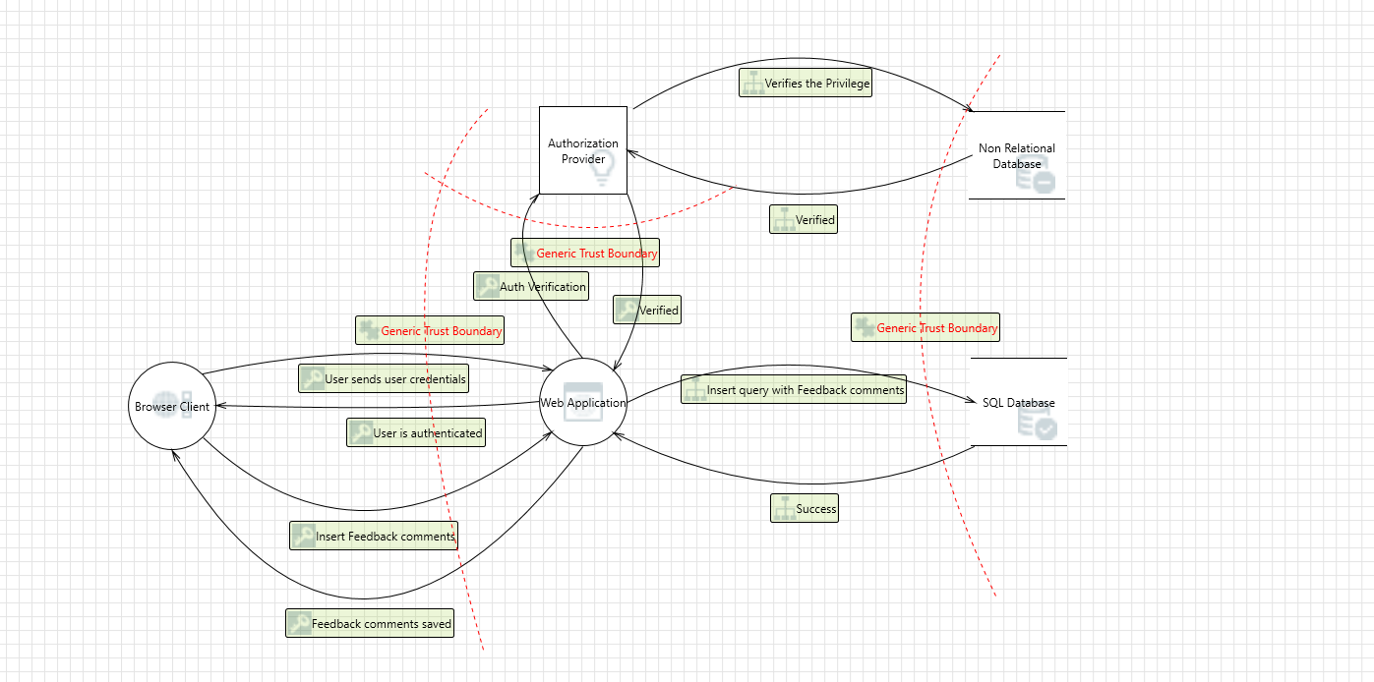
Flow Diagram of Feedback Sharing System

Slide 3
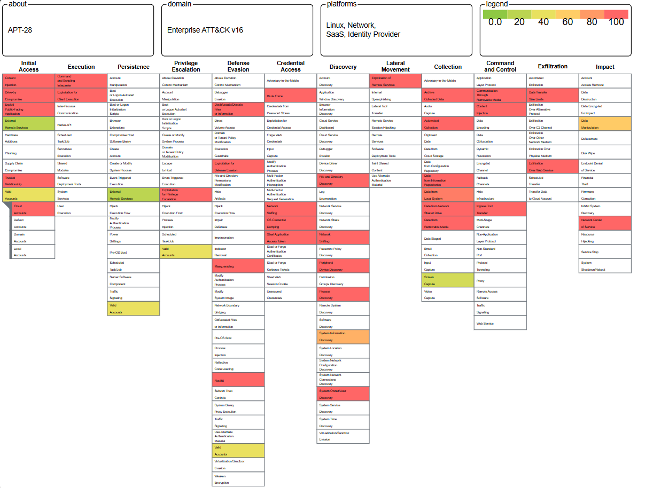
Group APT-28 Threats

Slide 4
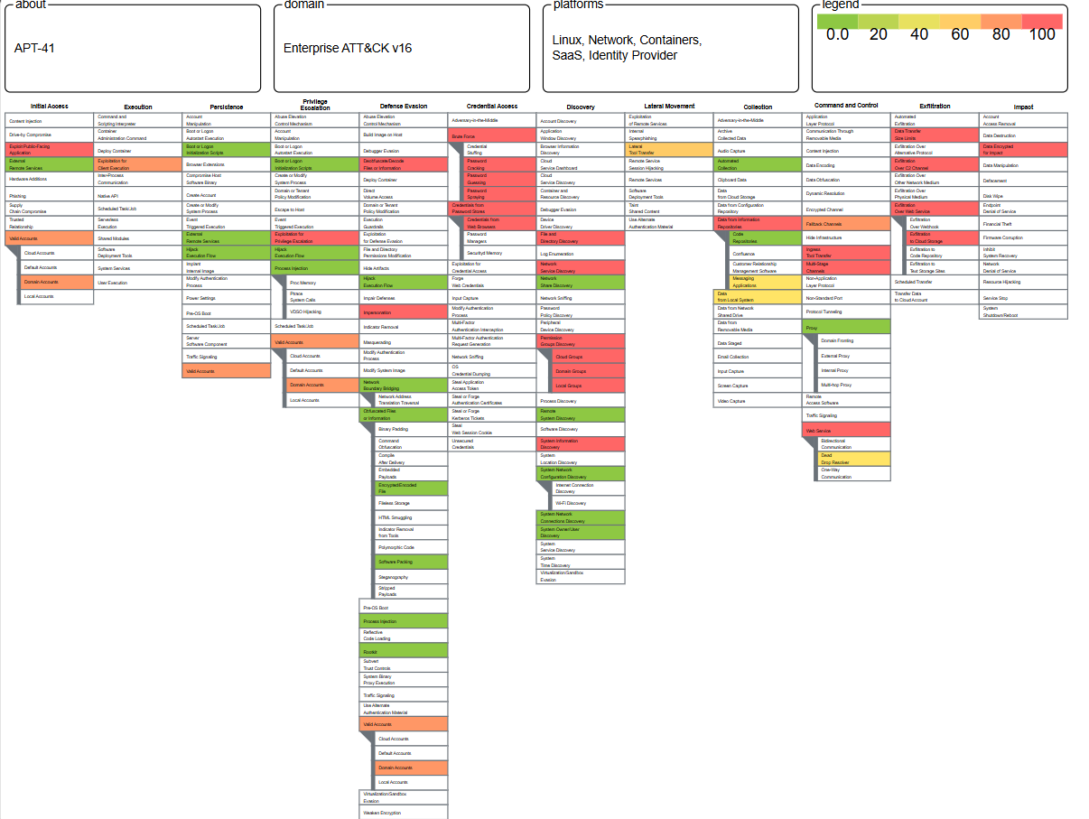
Group APT-48 Threats

Slide 5
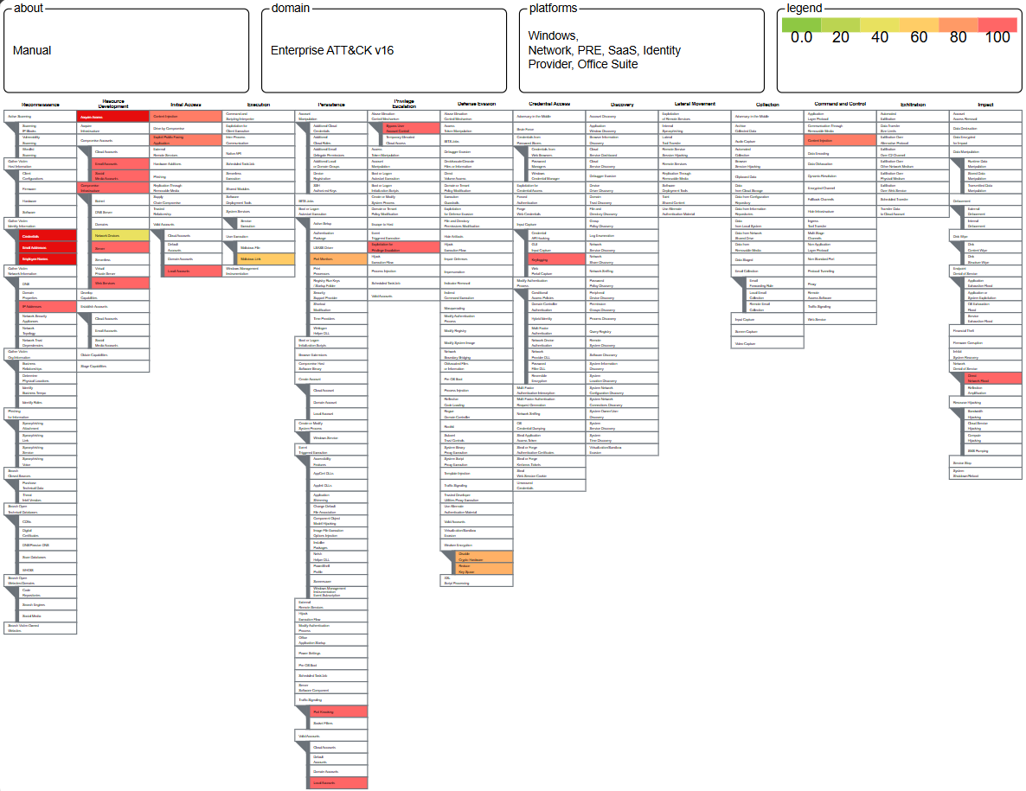
Group 3 Manually Identified Threats

Slide 6
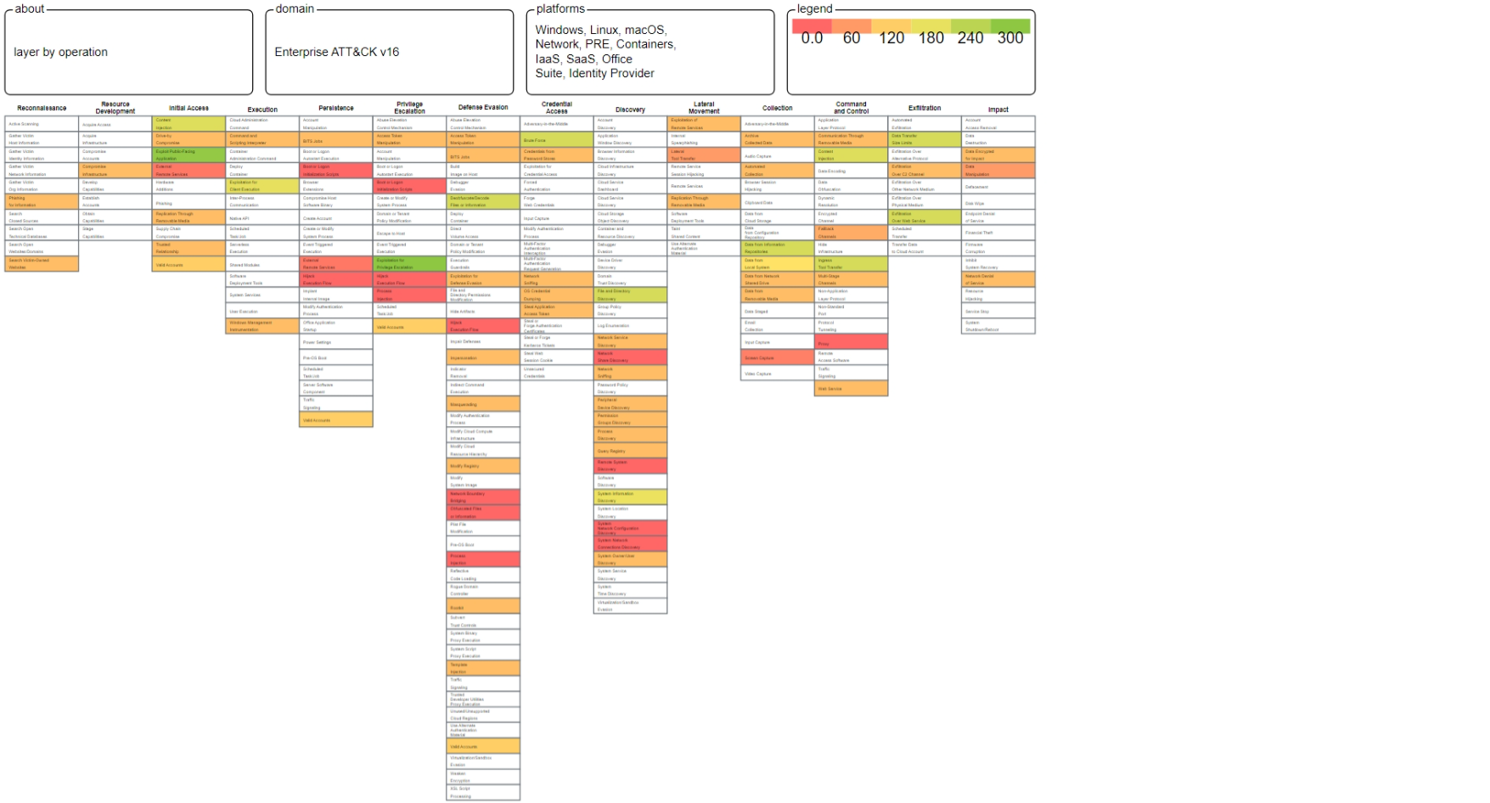
Combination of 3 Groups

Slide 7
JSON Files for reference of the 3 layers:

Slide 8
In the above MITRE and ATTCK framework we have used 3 layers threat mapping one is ATP group 28, APT group 48, and the third one is manually identified threats
In our manually identified threats like during initial access phase we have highlighted Pishing attacks, Gather identity information like their email id which may further lead to dictionary attacks. To mitigate pishing attacks user education and security awareness is required to prevent them.
In Resource development phase we have highlighted threats related to accounts compromise if pishing attack is executed successfully.
In the execution phase we have identified and highlighted execution of malicious files or links which may happen via pishing attacks after which in persistence phase attacker elevate the privileges and try to stay in the system without user knowledge
To mitigate threats related so malware execution regularly security updated must be patches because attacker tries to use a vulnerability and exploit them , we can also install some antivirus softwares in our system which will detect such malwares
We have also highlighted threats related to credential access through keylogging or password manager

Slide 9
In the command and control section we have highlighted content injection threat in which the attacker can inject malicious content in the website url to steal user credentials or redirect them to some other sites, to mitigate this threat regular inpur validation and sanitation must be maintained
Also as a security best practice a security audit must be performed yearly to check if all the controls are in place.
In the last slide we have combined the threats from the three layers

